Slide 1
Database Applications Building Web Sites with Django – Winter 2025
Dr. Charles Severance <csev@umich.edu>

Slide 2
My Goals for This Course
You learn to build and deploy Django applications
I want you to understand the architecture of a web application, from the front end to the back end to the database and all the details in between.
This is a lot of material and does not respond well to cramming – so don't let yourself fall behind
Those who stay will be Django developers.

Slide 3
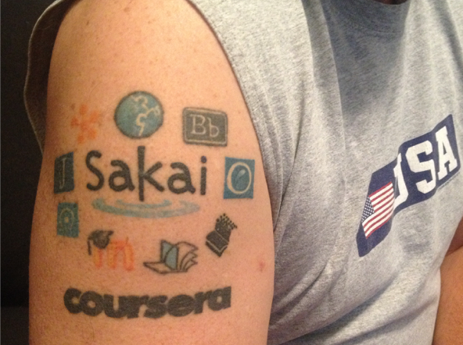
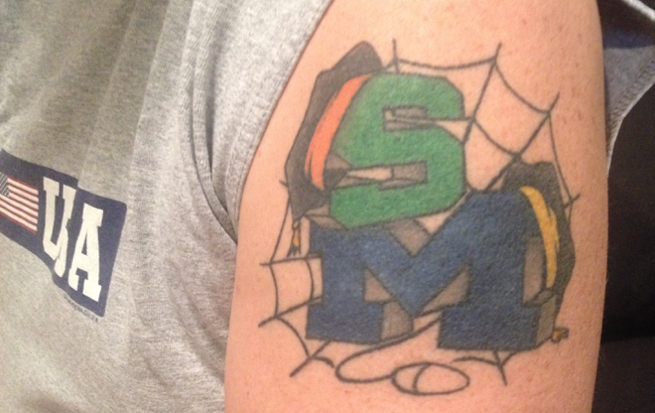
http://www.dr-chuck.com/
Twitter: @drchuck

Slide 4
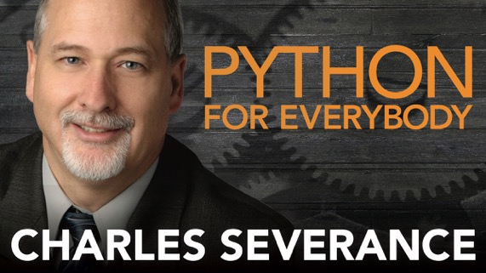
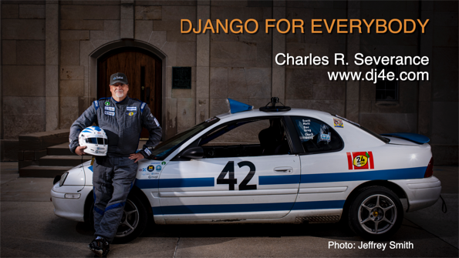


Slide 5
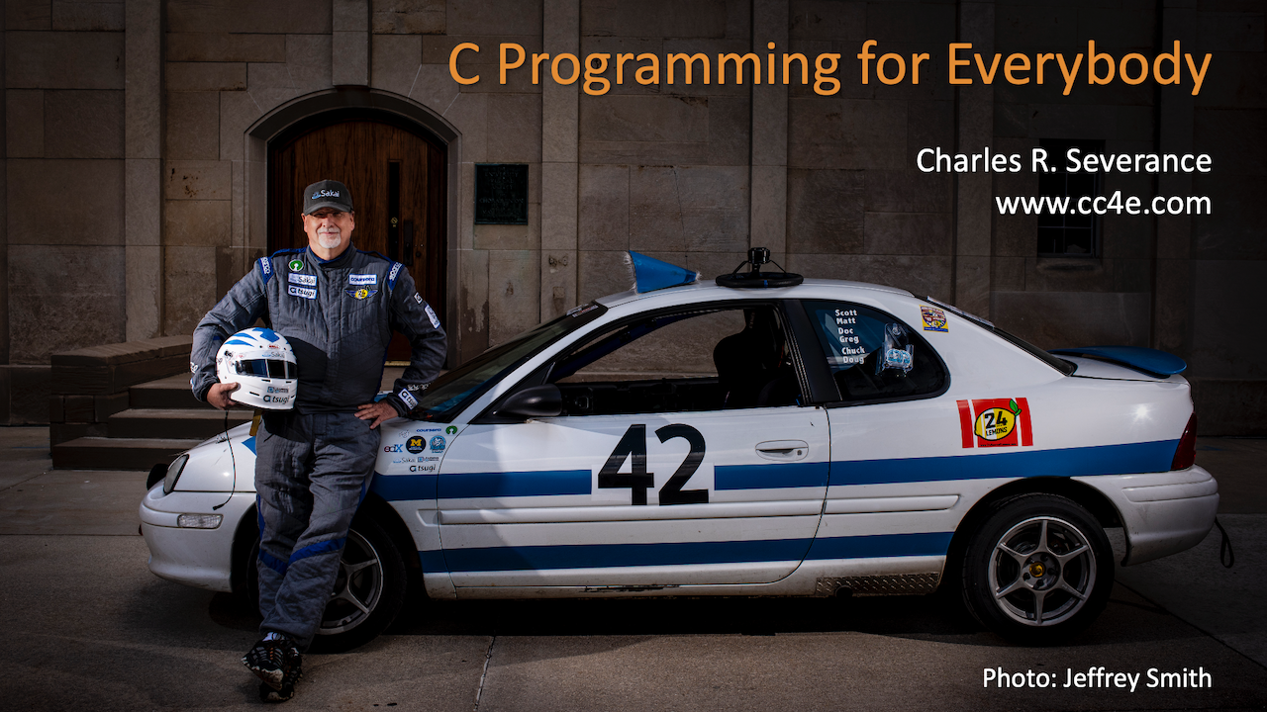

Slide 6
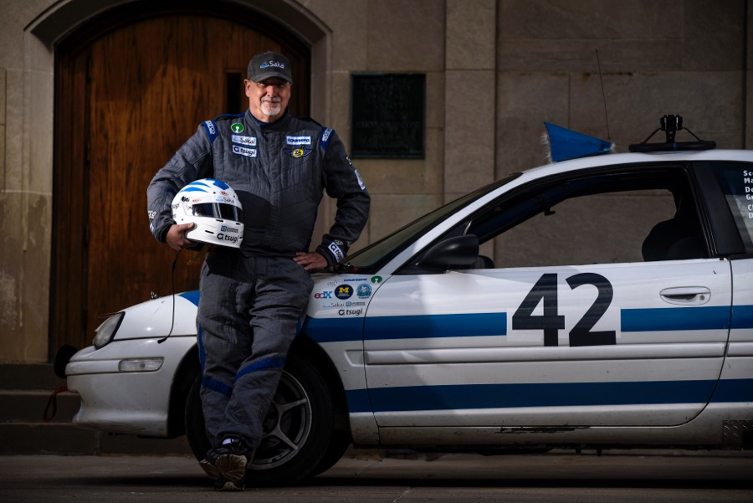
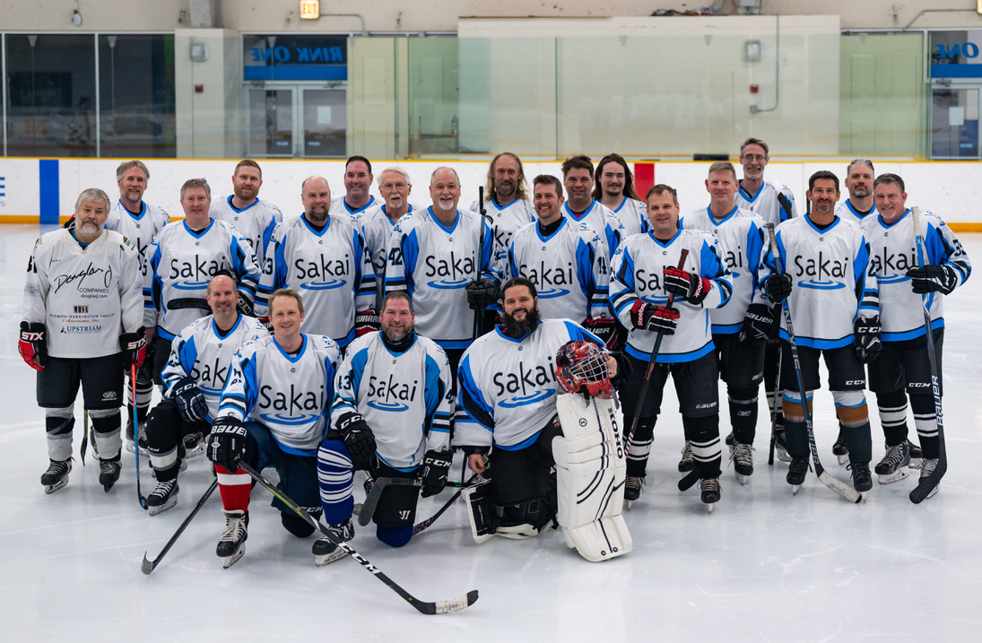
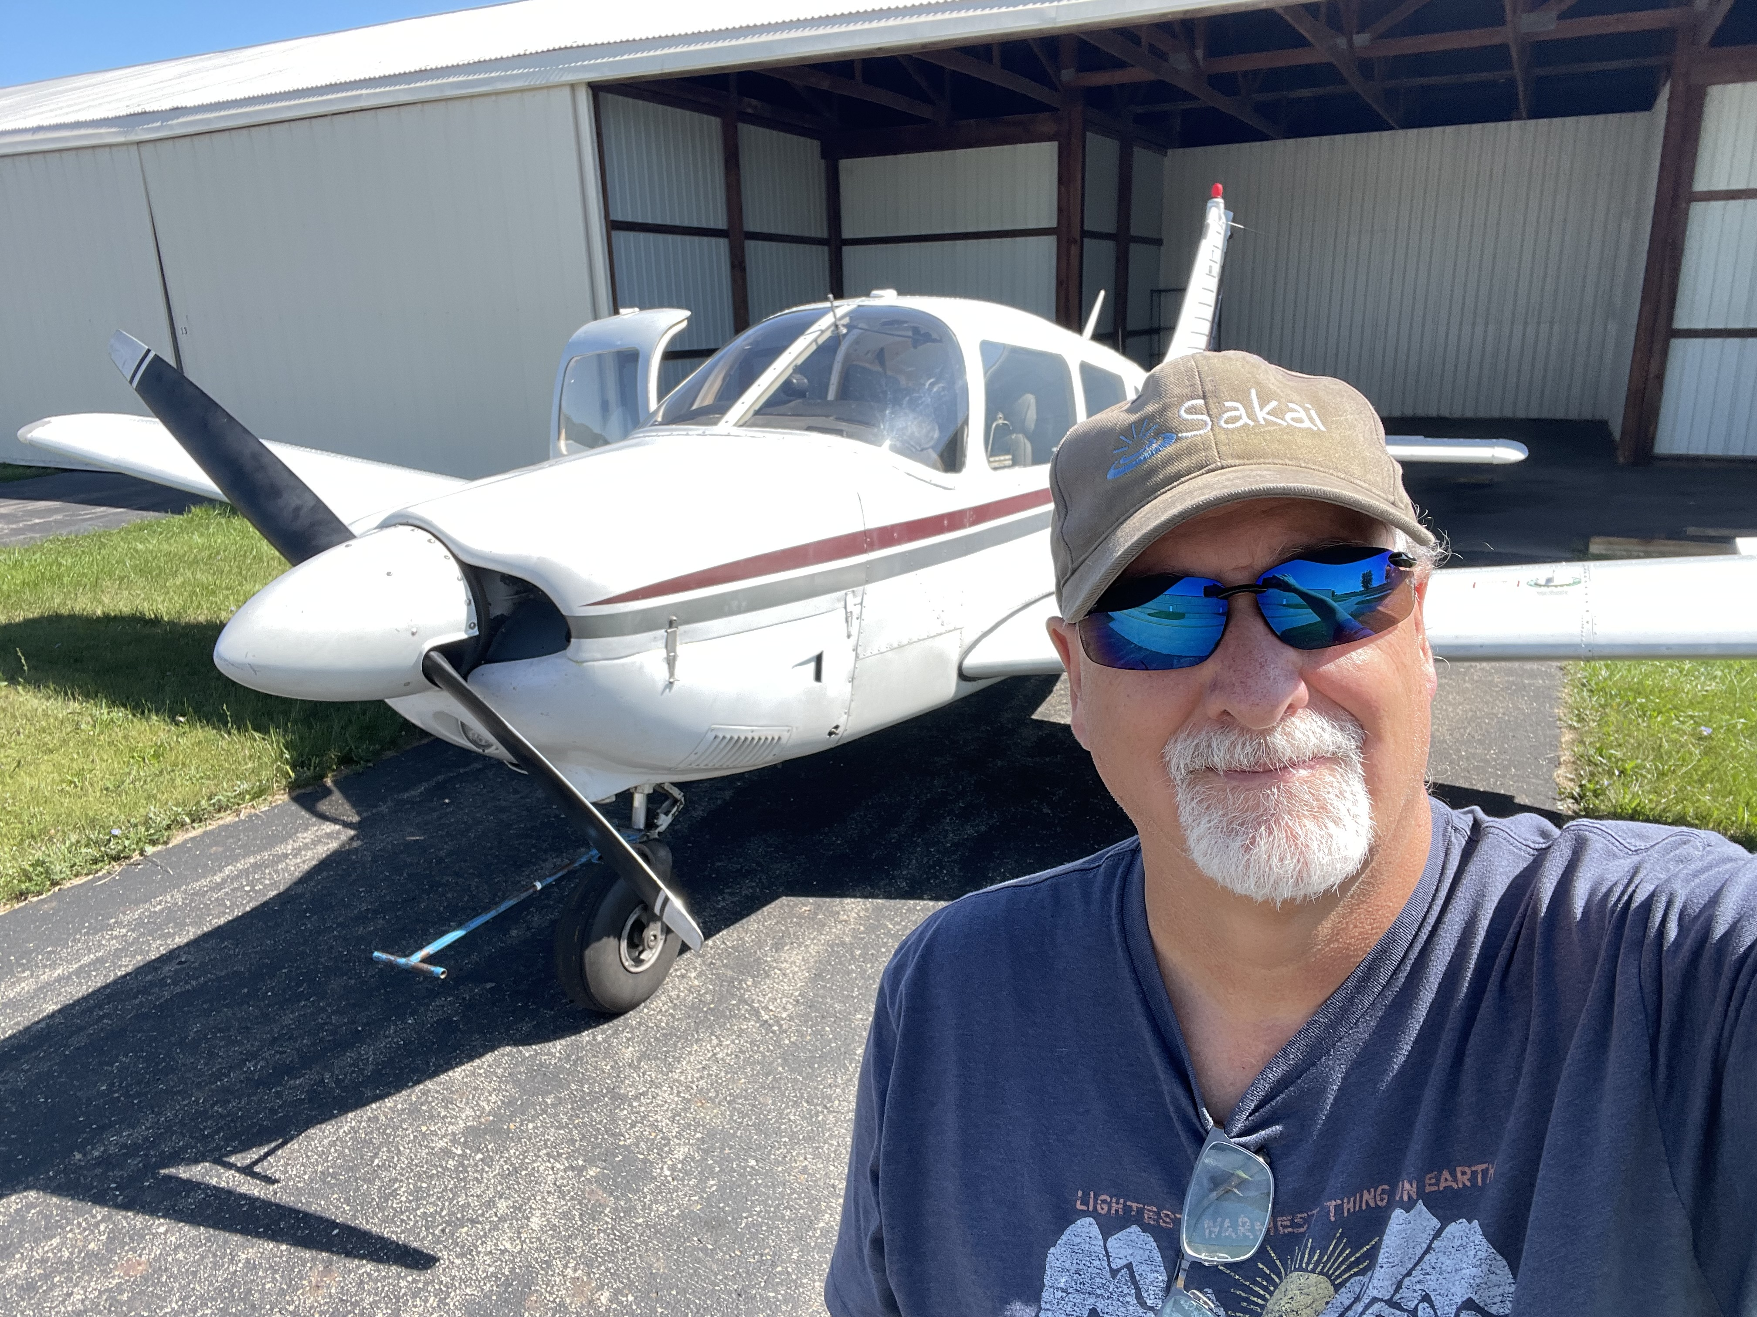

Slide 7
Hybrid Format - TL;DR
Friday lecture periods are online with Zoom, flipped, drop-in, and are not recorded
There will be about 30 minutes of "required viewing" video per week – this will have a due date, a quiz, and be graded
Discussions are also Hybrid with a combination of in-person and on Zoom at times
Required in-person attendance is rare

Slide 8

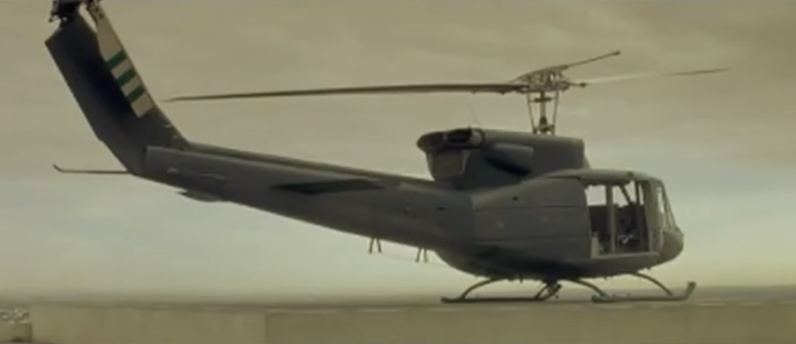
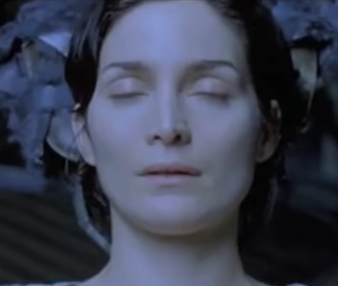



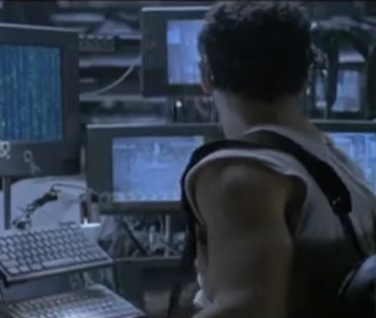
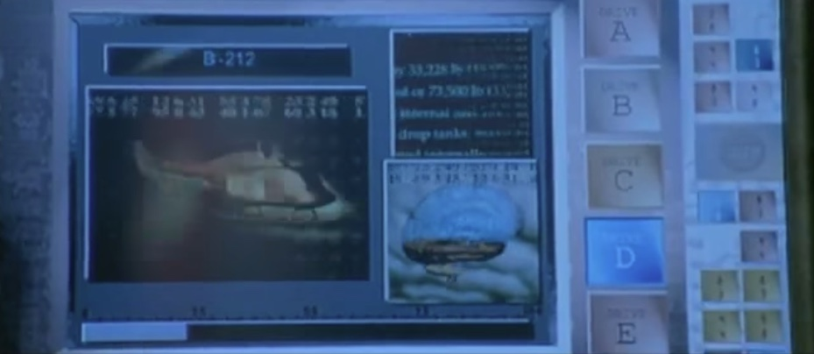

Why Hybrid?
https://youtu.be/zatL4uFRpC0

Slide 9
Exams
Midterm – In person, paper, 2 Hours
Closed book, closed notes, no Internet, no AI
One page of notes (2 sides)
Physical attendance is required
Final
Five days – flexible schedule, can start and stop
Online, open book, open notes, AI ok
Coding – auto-graded with unlimited tries

Slide 10
Policies
Pre-Requisites – Any programming language – Python preferred
Assignment late policy – 10% per day (see don't fall behind)
AI is OK – Be wary and careful. Take responsibility
Working together – acknowledge help, take responsibility

Slide 11
Assignments / Content Quizzes
The actual course content
About 1.5 hours per week of recorded lectures
One more more quizzes on the content each week
Can be taken multiple times
Several auto graded coding assignments
Will have a delay between submissions closer to the deadline
All these materials will be available in Sakai@UMSI, and must be accessed through Canvas.

Slide 12
Discussion Sections
Some slides, some clarification, some 1-1 assistance – dive into material in more depth
These are for your benefit
As long as you keep up with the material, attendance is optional
Don't skip discussion and then expect personal tutoring whenever you get stuck

Slide 13
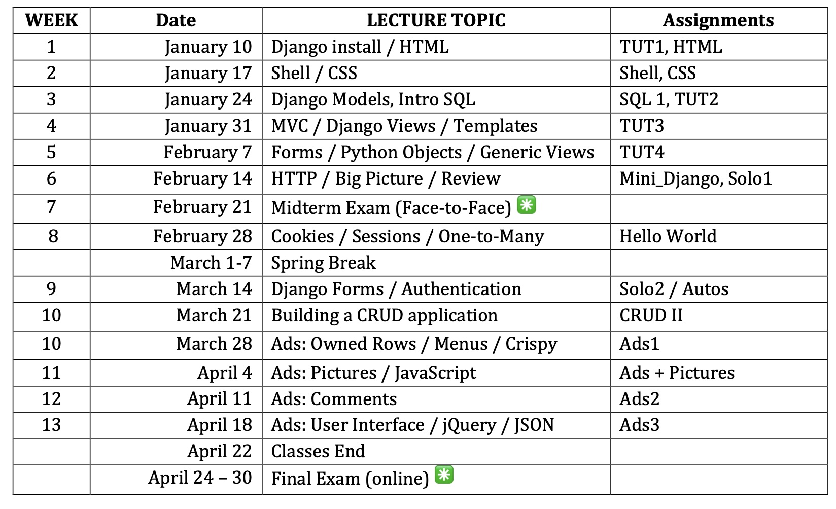

Slide 14
Grade Expectations
Most students will get 100% on every assignment except the written exams
Assignments
Quizzes
Final Exam
Why students get less-than hoped for grades
Fall behind
Do work without understanding
Don't watch lectures or do readings

Slide 15
Final Grade Computation
Straight scale from written syllabus
100% is an A not an A+
A+ is rare - up to the GSIs to award extraordinary work

Slide 16
Canvas and Sakai Tour

Slide 17
Some Technical bits..

Slide 18
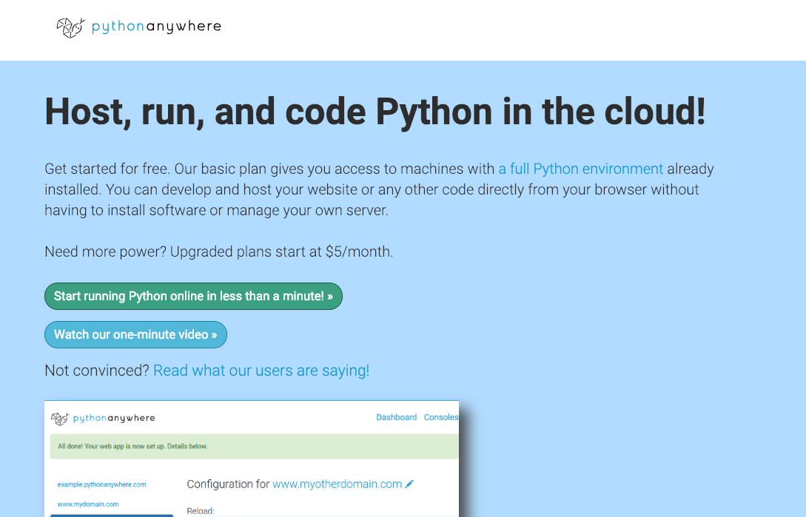
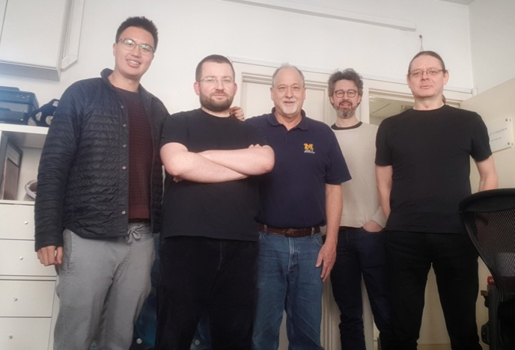

Slide 19
Python Type Hints (since 3.5)
from django.http import HttpResponse
def hello(req):
return HttpResponse("hello world")
from django.http import HttpRequest, HttpResponse
def hello(req: HttpRequest)-> HttpResponse:
return HttpResponse("hello world")

Slide 20
Weirdly Configured Browsers..
Virtually all of this course content functions in a browser.
Many of you have very tricked out browsers with lots of spyware blockers, add blocker, cookie blockers, etc.
Many of these will break things in this course
You will either need to turn these off or just use another browser for this course

Slide 21
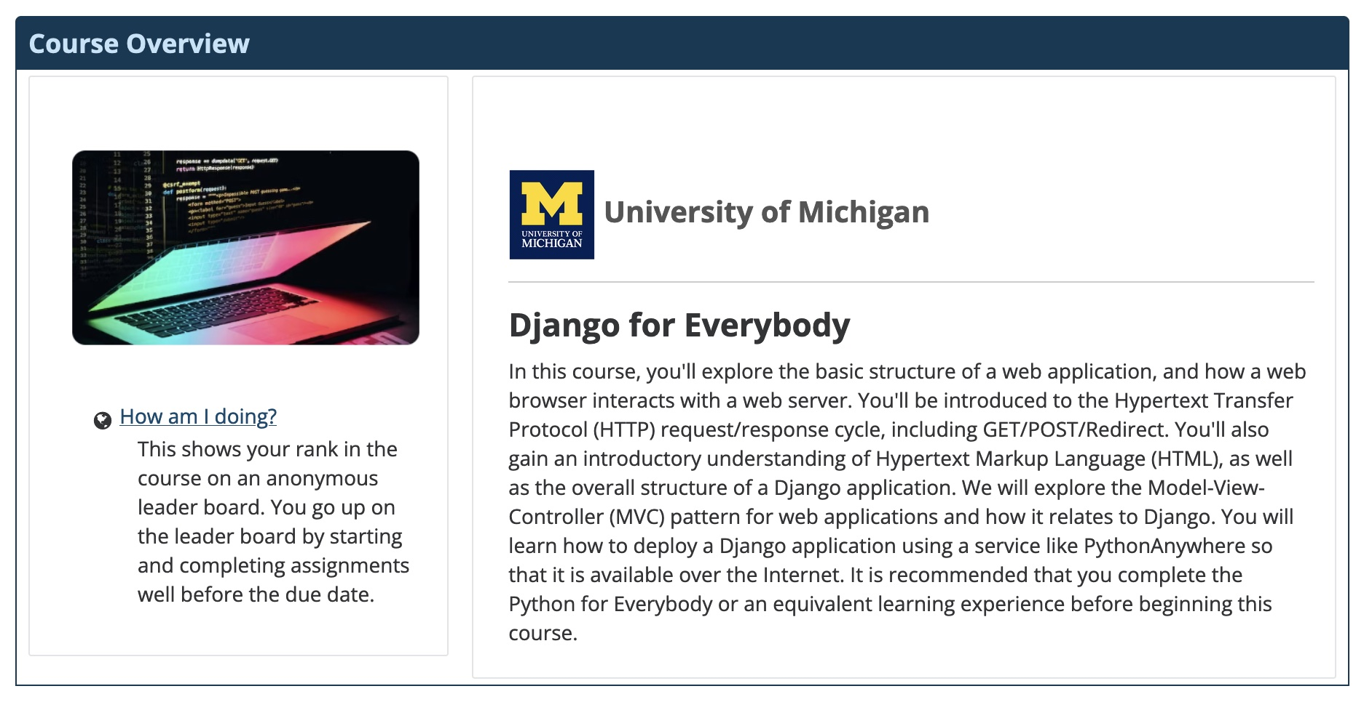

Slide 22
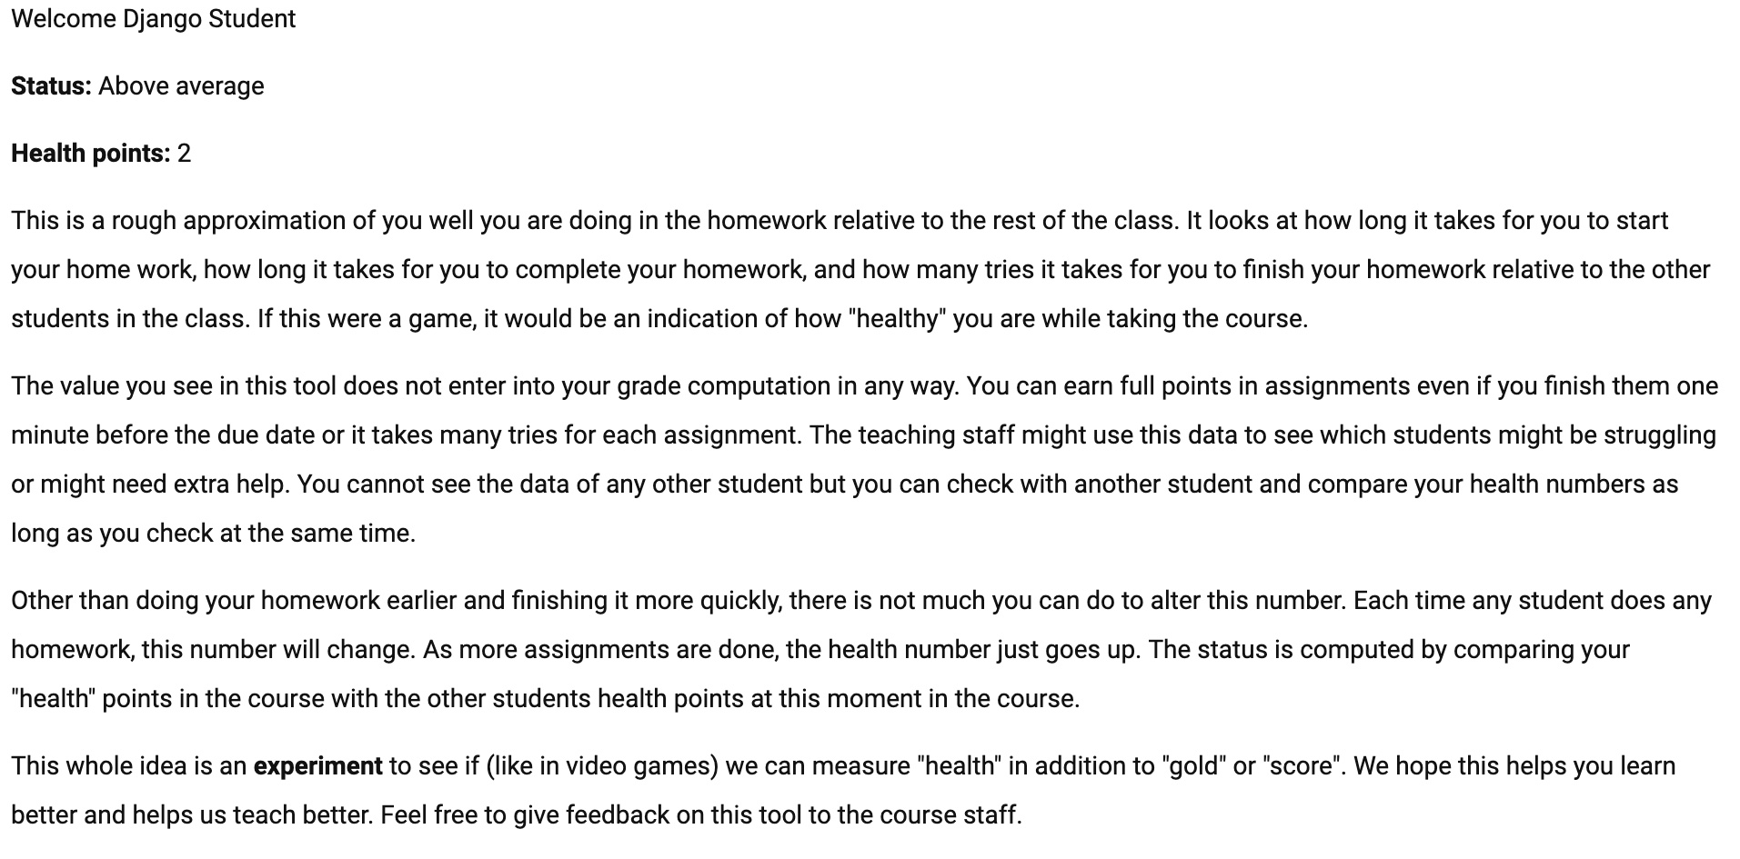

Slide 23
Plagiarism (FYI)
I am fascinated by plagiarism and have my own plagiarism checks in the auto graders
I will never use technology that invades your privacy
All student assignment activity in this class is stored in systems owned by University of Michigan
My goals
Have a course that can be done without cheating
Make assignments where cheating requires effort
Scan assignments looking for “cheating patterns”

Slide 24
AI Across Semesters
Winter 2023 – LLMs came out (November 22)
General agreement – do not prohibit AI
Find ways to teach "with AI"
Support "using AI wisely"
Fall 2023 – Fall 2024
Adjusted course to "corral" AI – mixed results
Winter 2025 – Treat AI like StackOverflow

Slide 25
To AI or not to AI?
Benefits of AI
From now on AI is part of programming
We want you to learn to use AI to make you better
Perils of AI
Using AI does not mean you don't need to learn anything in a programming class or in a job
Relying on AI to avoid studying or learning in the first part of a course is particularly perilous

Slide 26
After
Course
Content
and Skills
Before

Slide 27

The Zone of Proximal Development (ZPD) was a key construct in Lev Vygotsky's theory of learning and development. The Zone of Proximal Development is defined as the space between what a learner can do without assistance and what a learner can do with adult guidance or in collaboration with more capable peers.
10
9
8
7
6
5
4
3
2
1

Slide 28

Simpler assignments early in the course are often within the capabilities of the AI to complete. There is a temptation to use AI early in the course to avoid spending time studying and learning. Students may tell themselves that they will work extra hard and catch up on the learning later in the course.
10
9
8
7
6
5
4
3
2
1

Slide 29
When AI can no longer do the assignments on its own, the student cannot learn all the previous material in one week. Students start to lean on office hours and peers and that further delays actual learning and understanding of the course content.
10
9
8
7
6
5
4
3
2
1

Slide 30
AI Recommendations
Don't just rush to the assignments and try to smash through them without studying
The amount of video lecture in this course is usually 1.5 hour or less per week
Watch the lectures first so you have an outline
Don't be so impatient in the first few weeks
The course is designed to stretch you every week a little bit

Slide 31
Health and well being
See the syllabus for details and contact information to get help
The main point is that there are people there to help you
We encourage you to make use of these resources
You can always send email to csev@umich.edu for issues that are personal and private

Slide 32

Always improving…
There will be some cool things
Something might break
I will watch continuously
You are welcome to contact me – even text if something is really broken
I will be transparent and communicate when things go wrong and when they are fixed
We will fix stuff / adjust assignments / whatever

Slide 33
Any questions..
Come to Zoom on Friday or come in person
Or send me email csev@umich.edu

